Slide 1
Cascade Architectures
Notes:
Motivation to talk about cascade architecture -- tinyML -- tiny models -- lower accuracy, so can we do better?

Slide 2
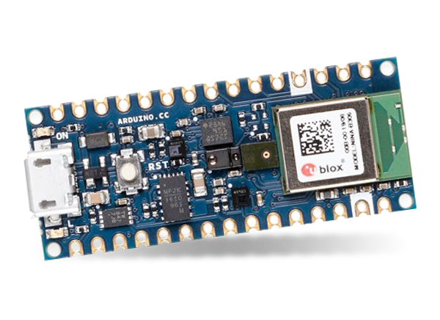
Our board [Course 3 Kit] only has 256KB of RAM (memory)

Slide 3
Input Data
Reshape
Softmax
Output Classification
Weights: <1,10,8,8>
Bias: <8>
DepthwiseConv2D
Weights: <4,4000>
Bias: <4>
FullyConnected
Our board [Course 3 Kit] only has 256KB of RAM (memory)
Notes:
TINYML is very specific and that’s where it is good vs. general in the cloud (tie back to the federated model)

Slide 4
10 x 8 x 8 + 8 = 648 parameters
4 x 4000 + 4 = 16,004 parameters
16,652
parameters
Input Data
Reshape
Softmax
Output Classification
Weights: <1,10,8,8>
Bias: <8>
DepthwiseConv2D
Weights: <4,4000>
Bias: <4>
FullyConnected
Our board [Course 3 Kit] only has 256KB of RAM (memory)
Notes:
TINYML is very specific and that’s where it is good vs. general in the cloud (tie back to the federated model)

Slide 5
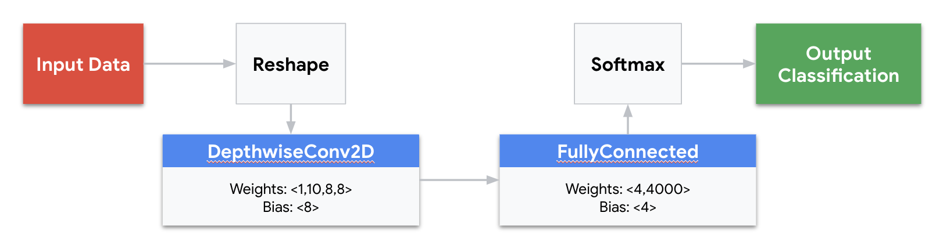
Trade-offs
Limited vocabulary
Limited accuracy
Limited user experience

Slide 6
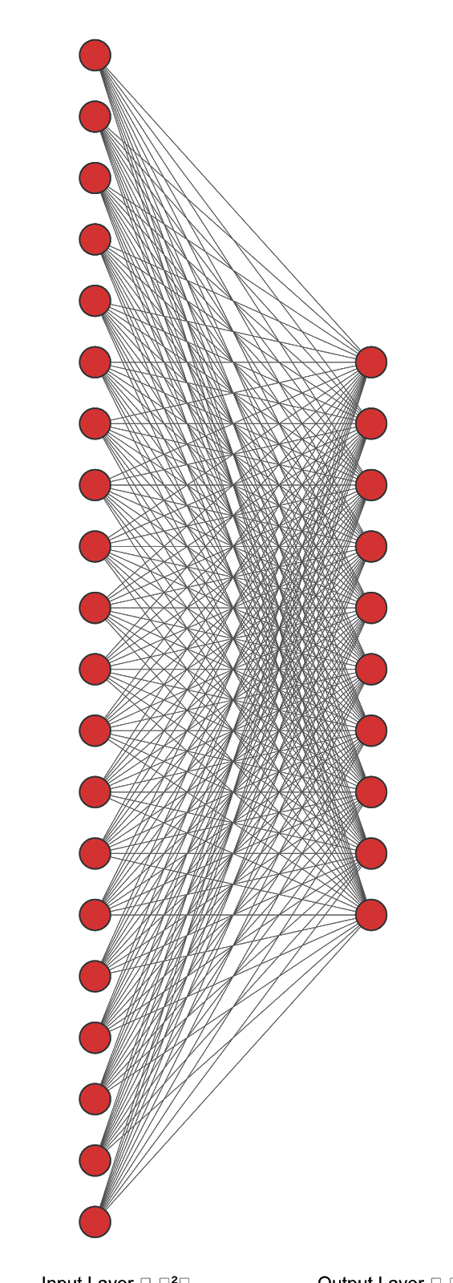


“Cascade” detection: a multi-stage model
4
Process the full speech data with a large model in the cloud
2
Process the data with TinyML at the edge
3
Send the data to the cloud when triggered
1
Continuously listen on the microcontroller
Notes:
Permissive to discriminative: Second stage model that’s more discriminative, send query to the cloud that’s even more accurate
Then the cloud can efficiently process a LARGE COMPLEX model to figure out the complex command
This is a federated approach!
IMAGE NOTE: Large Network drawn in 2-3-2 (ours, I hope)

Slide 7

“Cascade” detection: a multi-stage model
4
Process the full speech data with a large model in the cloud
2
Process the data with TinyML at the edge
3
Send the data to the cloud when triggered
1
Continuously listen on the microcontroller
Notes:
Permissive to discriminative: Second stage model that’s more discriminative, send query to the cloud that’s even more accurate
https://pixabay.com/vectors/batteries-loading-icons-set-flat-1379208/
Then the cloud can efficiently process a LARGE COMPLEX model to figure out the complex command
This is a federated approach!
IMAGE NOTE: Large Network drawn in 2-3-2 (ours, I hope)

Slide 8
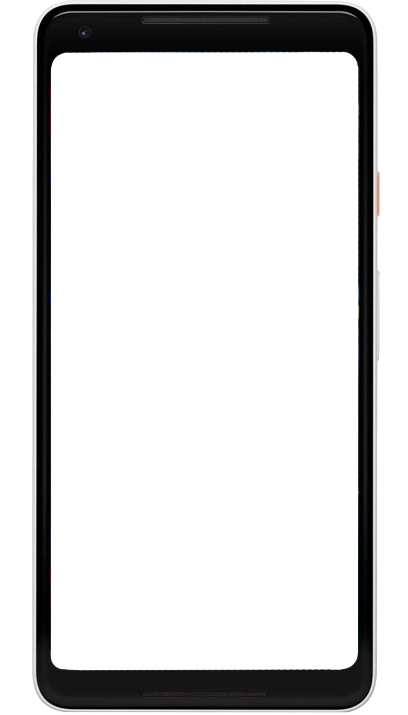
“Cascade” detection: a multi-stage model
5
Process the full speech data with a large model in the cloud
2
Process the data with TinyML at the edge
3
Process on a secondary larger model on a larger local device
1
Continuously listen on the microcontroller
4
Send the data to the cloud when triggered
Notes:
Permissive to discriminative: Second stage model that’s more discriminative, send query to the cloud that’s even more accurate
https://pixabay.com/vectors/batteries-loading-icons-set-flat-1379208/
Then the cloud can efficiently process a LARGE COMPLEX model to figure out the complex command
This is a federated approach!
IMAGE NOTE: Large Network drawn in 2-3-2 (ours, I hope); I think its one LM generated using neuralnet. --alex/HX

Slide 9
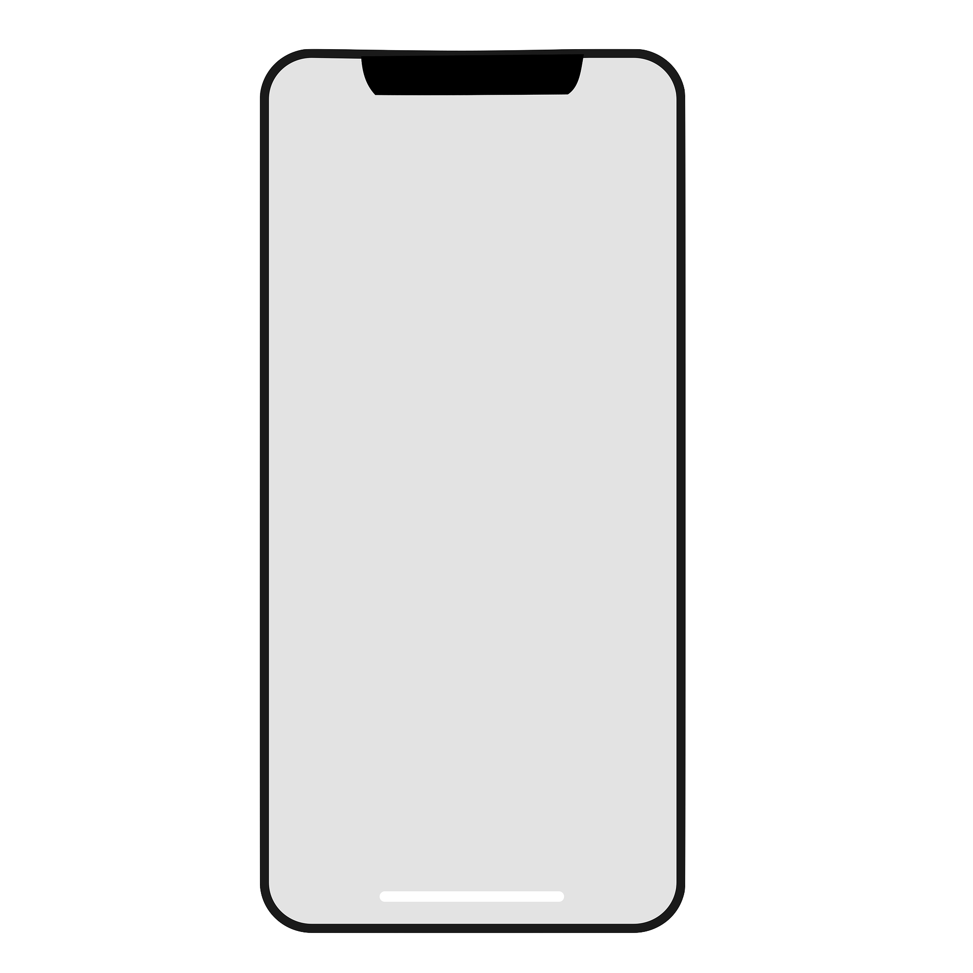
“Hey Siri”
“Hey Siri”
Core Audio
Notes:
https://machinelearning.apple.com/research/hey-siri
https://pixabay.com/illustrations/iphone-x-iphone-x-mockup-iphone-3365689/

Slide 10
“Hey Siri”
Voice Trigger
Detector
“Hey Siri”
Core Audio
Notes:
https://machinelearning.apple.com/research/hey-siri
https://pixabay.com/ru/illustrations/%D0%B0%D0%B9%D1%84%D0%BE%D0%BD-%D1%85-%D0%BC%D0%BE%D0%B1%D0%B8%D0%BB%D1%8C%D0%BD%D1%8B%D0%B9-%D1%85-%D0%BC%D0%B0%D0%BA%D0%B5%D1%82-iphone-3365689/

Slide 11
“Hey Siri”
Cloud
Servers
Voice Trigger
Detector
“Hey Siri”
Core Audio
Notes:
https://machinelearning.apple.com/research/hey-siri
https://pixabay.com/ru/illustrations/%D0%B0%D0%B9%D1%84%D0%BE%D0%BD-%D1%85-%D0%BC%D0%BE%D0%B1%D0%B8%D0%BB%D1%8C%D0%BD%D1%8B%D0%B9-%D1%85-%D0%BC%D0%B0%D0%BA%D0%B5%D1%82-iphone-3365689/

Slide 12
“Hey Siri”
Cloud
Servers
Voice Trigger
Detector
Always On
Preprocess Audio
TinyML
“Hey Siri”
Core Audio
Notes:
https://machinelearning.apple.com/research/hey-siri
https://pixabay.com/ru/illustrations/%D0%B0%D0%B9%D1%84%D0%BE%D0%BD-%D1%85-%D0%BC%D0%BE%D0%B1%D0%B8%D0%BB%D1%8C%D0%BD%D1%8B%D0%B9-%D1%85-%D0%BC%D0%B0%D0%BA%D0%B5%D1%82-iphone-3365689/

Slide 13
“Hey Siri”
Cloud
Servers
Voice Trigger
Detector
More
Accurate
Larger NN
Always On
Preprocess Audio
TinyML
“Hey Siri”
Core Audio
Notes:
https://machinelearning.apple.com/research/hey-siri
https://pixabay.com/ru/illustrations/%D0%B0%D0%B9%D1%84%D0%BE%D0%BD-%D1%85-%D0%BC%D0%BE%D0%B1%D0%B8%D0%BB%D1%8C%D0%BD%D1%8B%D0%B9-%D1%85-%D0%BC%D0%B0%D0%BA%D0%B5%D1%82-iphone-3365689/

Slide 14
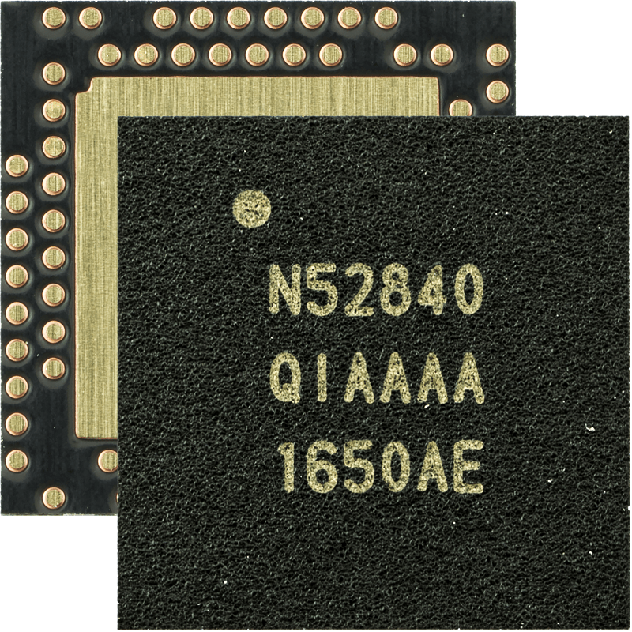
“Hey Siri”
Cloud
Servers
Voice Trigger
Detector
More
Accurate
Larger NN
Always On
Preprocess Audio
TinyML
Core Audio
Notes:
https://machinelearning.apple.com/research/hey-siri
https://pixabay.com/ru/illustrations/%D0%B0%D0%B9%D1%84%D0%BE%D0%BD-%D1%85-%D0%BC%D0%BE%D0%B1%D0%B8%D0%BB%D1%8C%D0%BD%D1%8B%D0%B9-%D1%85-%D0%BC%D0%B0%D0%BA%D0%B5%D1%82-iphone-3365689/

Slide 15
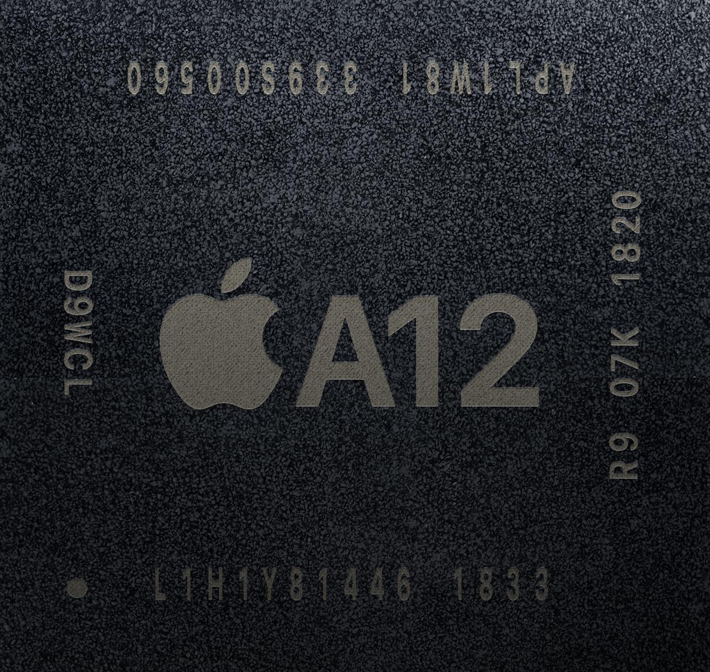
“Hey Siri”
Cloud
Servers
Voice Trigger
Detector
More
Accurate
Larger NN
Always On
Preprocess Audio
TinyML
Core Audio
Notes:
https://machinelearning.apple.com/research/hey-siri
https://pixabay.com/illustrations/iphone-x-iphone-x-mockup-iphone-3365689/

Slide 16
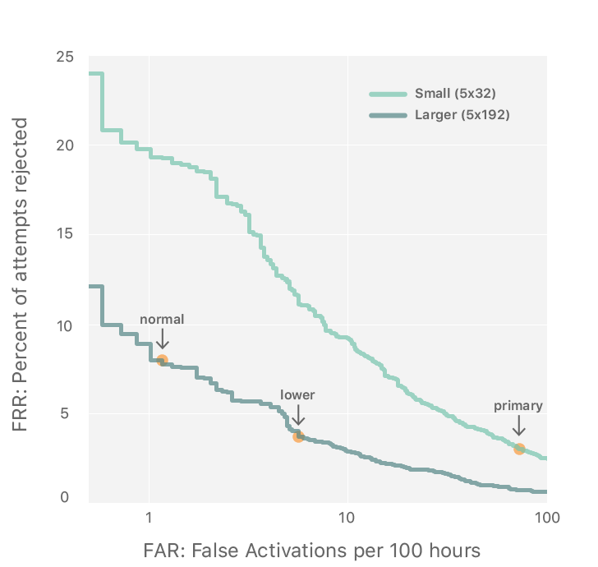
“Hey Siri”
More Accurate
Larger NN
Preprocess Audio
TinyML
Always On
Notes:
https://machinelearning.apple.com/research/hey-siri

Slide 17
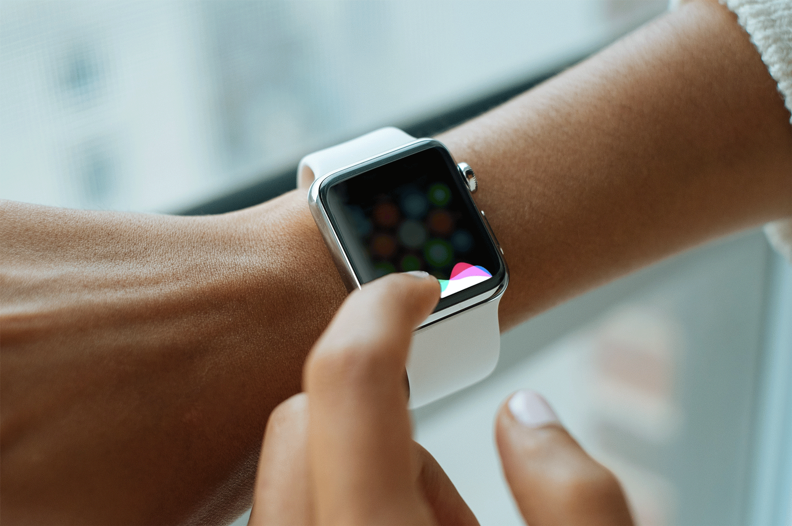
Notes:
Or perhaps you have said Hey Siri!
===
https://search.creativecommons.org/photos/7df7b01f-ccba-4c45-ab7d-a421c89b3913 Edits to make it a GIF my own (Dhilan R)

